Slide 1


Testing a React App

Slide 2

Testing with React Test Renderer
We have learnt how to test with React Testing Library.
React test renderer works a little different.
It renders a Component into a JavaScript Object.
What is important to know about this? That is not based on how a Node looks on a DOM or virtual environment. It is about comparing that object on how it looks and how it should look.

Slide 3
Testing with React Test Renderer
Has a create method.It doesn’t use the real DOM,
Has an act method, which prepares the component for assertions (takes a fc as parameter)
Combines really well with Jest snapshot testing feature.

Slide 4
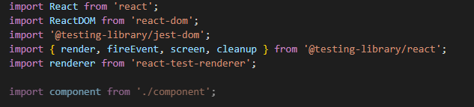
Basic Testing - Boilerplate
react-test-renderer.renderer: Renders React components into JavaScript Objects, without depending on a DOM or environment. It allows to create a snapshot - a JSON that represents the DOM tree - and compare it to other one. The advantage of snapshot testing is that is faster.

Slide 5
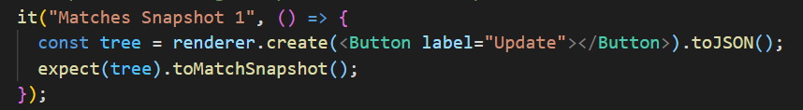
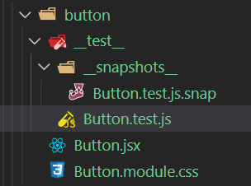
Basic Testing - Snapshot testing
Running the test, will create a JSON file inside the __test__ file.
Lets you take a snapshot of a component at certain time and how it looks like (what it rendered onto the page).Everytime you run the test, Jest checks that it matches the snapshot stored.

Slide 6
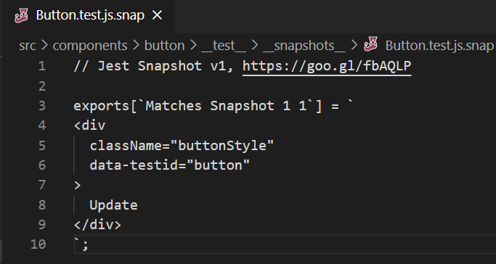
Basic Testing - Snapshot testing
How a snapshot looks like

Slide 7
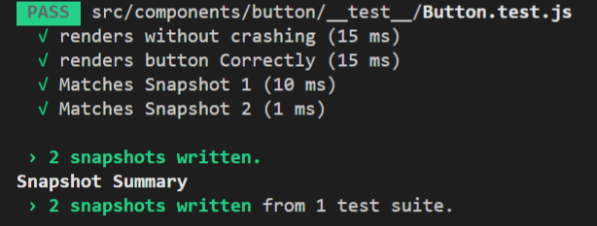
Basic Testing - Snapshot testing
The first time you run the snapshot test, the snapshots will be written. And since your code is updated with the snapshot, it will pass the test.

Slide 8
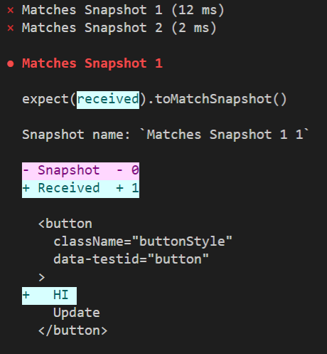
Basic Testing - Snapshot testing
If we perform a modification on our code, it won’t pass anymore the test: the snapshots won’t match.
The good thing about Snapshots, is that they can catch typos, or if the elements changed order, or anything else. So it is very important to have a good snapshot to compare it to.
Upon a snapshot test not passing, you will have the option to save it again. Be careful that you are saving a snapshot that matches how it needs to be, and not overwriting with one that it doesn’t
You don’t always need to update the snapshot.

Slide 9
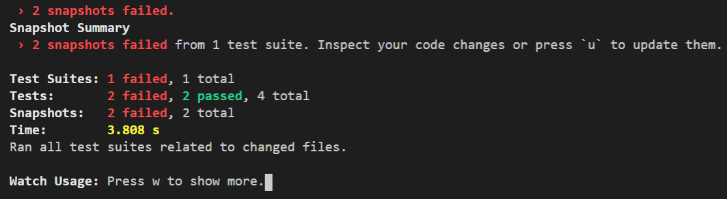
Basic Testing - Snapshot testing
At this point, we can:
Fix our code to match the snapshot
Update the snapshot to match our code

Slide 10
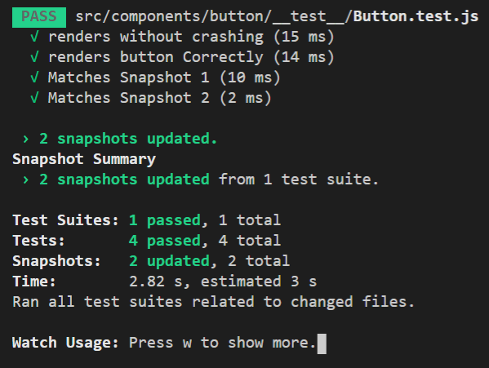
Basic Testing - Snapshot testing
If we choose to update them, we will be passing again the tests:

Slide 11
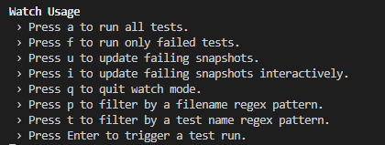
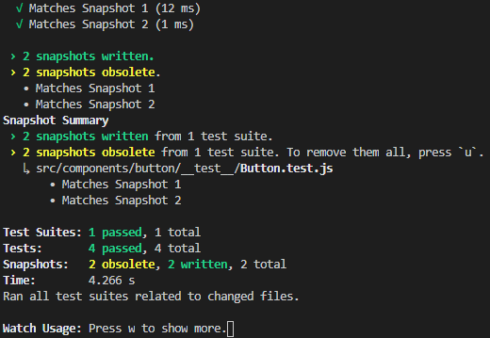
Snapshots

